Slide 1

Capstone Project Presentation
Healthcare Data Analytics Platform
SHAURYA POTDUKE[22070521011]
RUTHVEK KANAN [22070521031]
SHREYAS KASTURE [22070521032]
Group No: 83
Sem: 6
Under the guidance of
Dr. Piyush Chauhan
Symbiosis Institute of Technology, Nagpur Campus

Slide 2
Introduction
In modern healthcare, data-driven decision-making is essential for improving patient outcomes, enhancing user engagement, and optimizing healthcare resources. Despite the growing adoption of digital health platforms, many organizations struggle to analyze user behavior, feature adoption, and platform usability effectively. This project bridges that gap by building a Healthcare Data Analytics Platform that not only visualizes engagement trends but also leverages predictive modeling to identify factors influencing user satisfaction, accessibility, and health-related interactions. The insights derived can serve as a benchmark for developing better healthcare technology solutions that cater to patient and caregiver needs.

Slide 3
Objectives
To Collect and Analyze Healthcare Data
To Identify Key Factors Influencing User Satisfaction
To Visualize Data Through Dashboards
To Apply Machine Learning Models for Prediction and Insights
To Recommend Future Enhancements Based on Analytical Findings

Slide 4
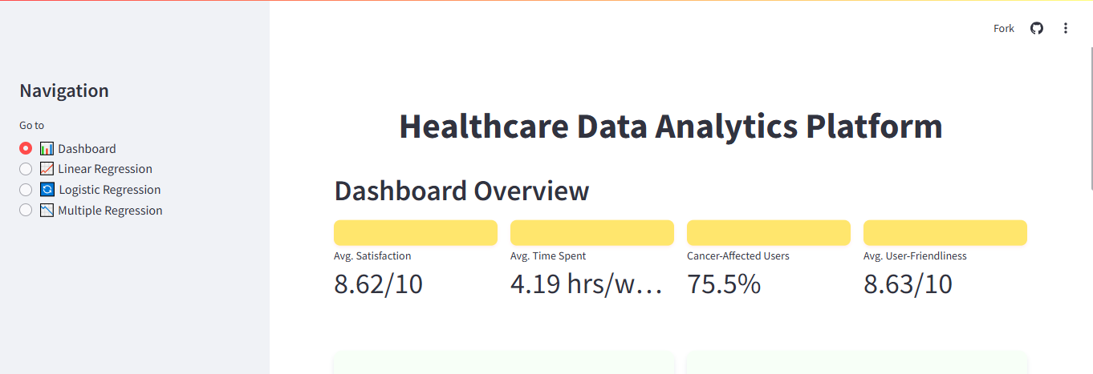
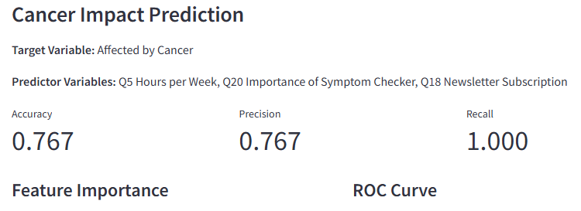
Methodology
Data Preprocessing & Cleaning
Exploratory Data Analysis (EDA)
Machine Learning Models
Linear Regression
Logistic Regression
Multiple Regression
Interactive Visualizations
Cloud Deployment

Slide 5
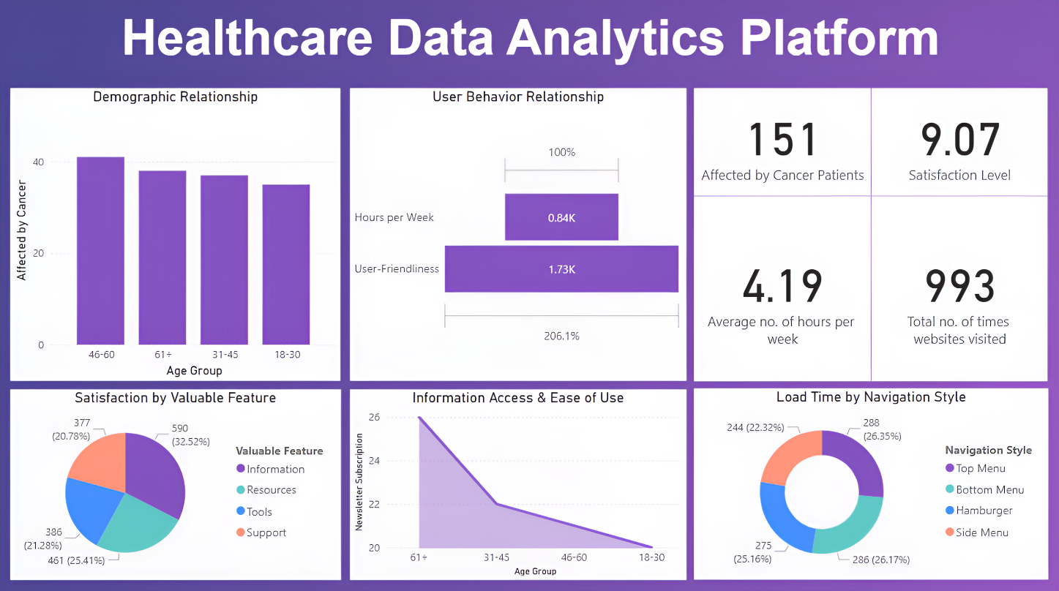
Key Findings / Results

Slide 6
Conclusion & Future Scope
The project successfully analyzed user data to enhance the CARF platform using regression models and visual tools. It identified key factors affecting satisfaction, usability, and engagement. The system provided interactive insights via Streamlit and Power BI. In the future, the platform can include real-time data, advanced models, and personalized recommendations. This will help CARF make data-informed improvements and better serve users.

